Slide 1


Event and ticket management
Dario D’Ercole (288643)
Giovanni Spaziani (295397)
Project for S.O.S.E, A.Y. 24/25

Slide 2


Table of contents
An initial description of this project.
Services involved in this application.
Simplified service architecture.
Service architecture.
Project structure.
Pom.xml.
SwaggerUI definition.
Explanation of all services.
Client side asynchrony in the project.
Dockerization of all services.

Slide 3
An initial description of this project
The ticket and event management system offer services aimed at organizing events, listing merchandise for them and ticket booking. Following a short list of the services:
For the customer:
Exploration of the event catalogue.
Visualization of the details of an event, including the merchandise.
Visualization of the available of tickets for an event, with the option to book them.
Visualization of the booked tickets’ history.
Event feedback submission.
For the organizer:
Creation of a new event, including the tickets.
Creation of new merchandise.
Modification of merchandise listed under an event.
Requesting a report on feedbacks and ticket sales of an event.

Slide 4
Services involved in this application
Service | Type | Description
EventManagementSOAP | Provider | A SOAP service that includes: 1. Events - creating, updating and deleting events. 2. Feedback - creating, updating and deleting feedback on events. 3. Tickets - management of ticket purchases.
AuthenticatonREST | Provider | A REST service useful for authenticating two types of users (organizers and customers) within the system.
MerchandisingREST | Provider | A REST service that coordinates and provides all information relating to merchandising items during the event.
FeedbackProsumerREST | Prosumer | A REST service that aggregates feedback with the data of the users who left it, for use in reports.
SalesAnalysisProsumerREST | Prosumer | A REST service that analyzes ticket sales data to provide statistics and reports to event organizers.
EventMerchProsumerREST | Prosumer | A REST service that aggregates events with related merchandising.

Slide 5
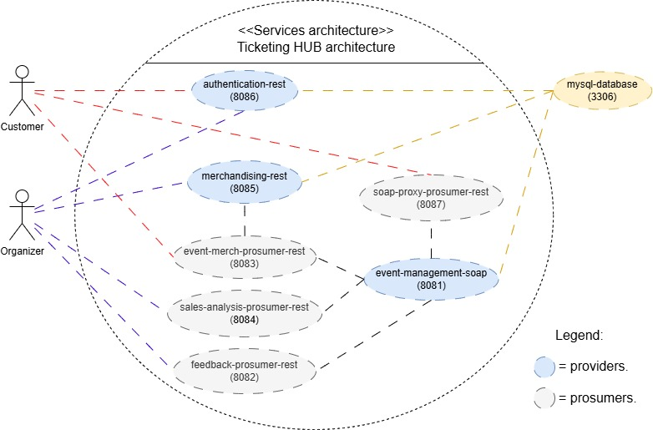
Simplified service architecture
With this service architecture, we can see the interaction between services and between clients and services.
Each service lists the port it listens on.
All the providers have a DataBase connected to them.

Slide 6
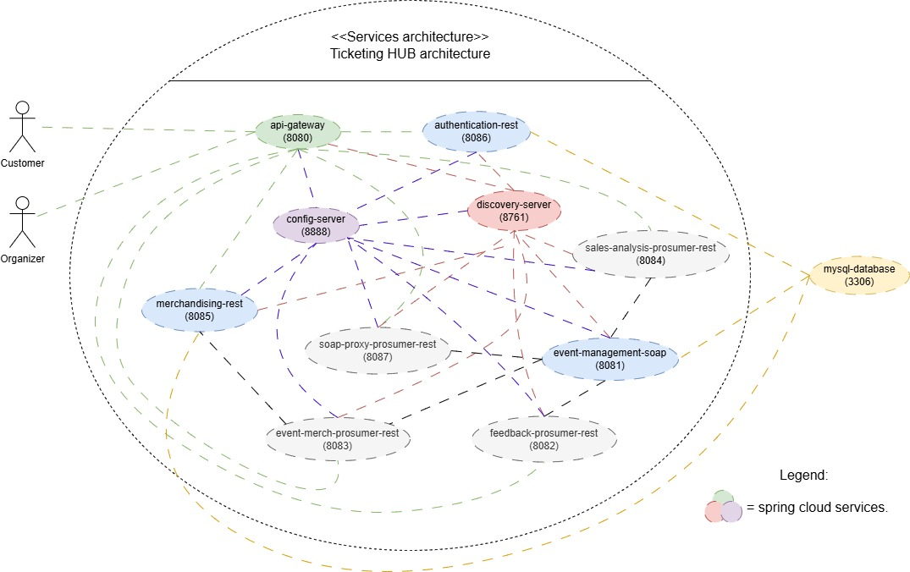
Service architecture
This version includes Spring Cloud services.
Api-gateway: Exposes pathways to the services, while masking internal structure of the microservice system.
Discovery-server: provides information on running service’s instances.
Config-server: provides configuration for all the services.

Slide 7
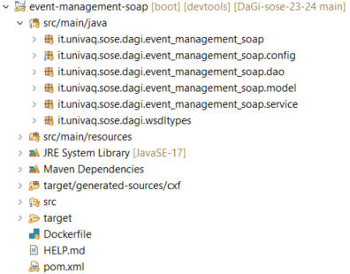
Projects structure: SOAP provider
This project contains the following packages:
«root»: contains the entrypoint class.
«root.config»: contains a configuration class setting up the web service endpoint.
«root.dao»: contains Spring Data JPA repositories to provide access to the data source.
«root.model»: contains the model classes.
«root.service»: contains the service classes implementing the persistence layer. Two alternative implementations are provided, using java collections and JPA repositories.
«root.wsdltypes»: contains the (controller) class implementing the web service interface generated from the WSDL (located in the selfsame package found under target/generated-sources/cxf)

Slide 8
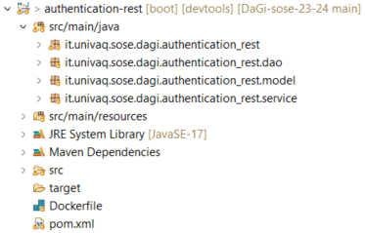
Projects structure: REST provider
This project contains the following packages:
«root»: contains classes for the entrypoint (and bean definitions), JAX-RS API definition and its implementation.
«root.dao»: contains Spring Data JPA repositories’ interfaces to provide access to the data source.
«root.model»: contains the model classes.
«root.service»: contains the service classes implementing the persistence layer. Two alternative implementations are provided, using java collections and JPA repositories.

Slide 9
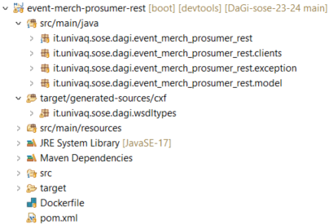
Projects structure: prosumers
This project contains the following packages:
«root»: contains classes for the entrypoint (and bean definitions), JAX-RS API definition and its implementation.
«root.clients»: contains classes implementing the consumer side of the prosumer.
«root.exception»: contains code to handle exceptions thrown in the controller class (does not work unless using pure Spring Boot REST controllers).
«root.model»: contains the model classes.
«root.wsdltypes»: prosumers interacting with the SOAP provider make use of this package, generated from the WSDL, to implement a SOAP client.

Slide 10
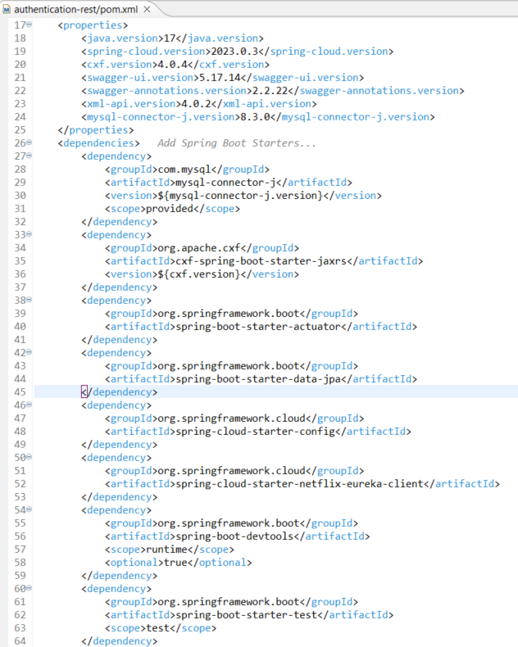
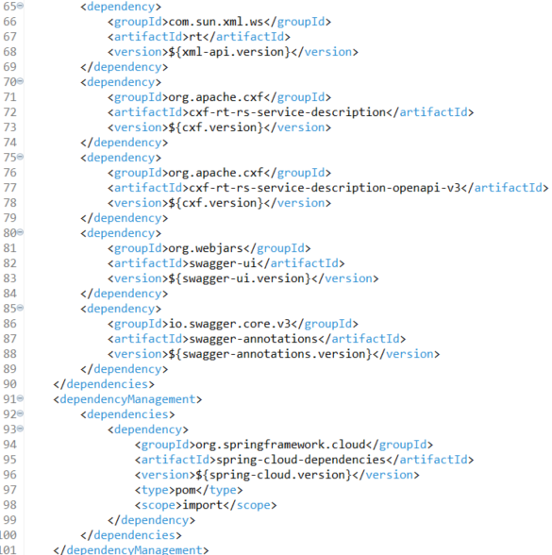
Pom.xml: REST providers
1
This dependency is used in building REST services with JAX-RS.
1
This dependency is used in building Eureka client to implement load-balancing.
2
These dependencies are used to generate Swagger documentation.
2

Slide 11
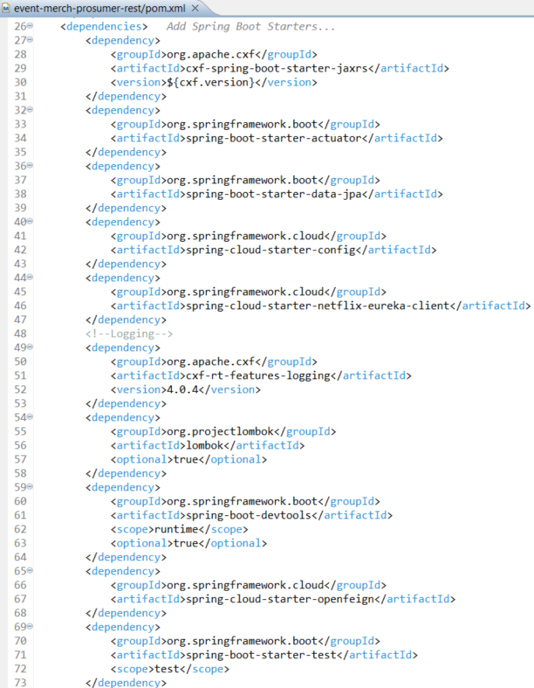
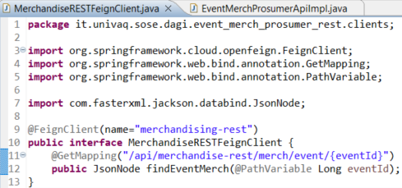
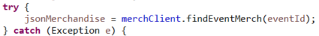
Pom.xml: REST prosumers
This dependency is used in building load-balanced REST clients in conjunction with Eureka client.
At runtime, it creates a REST client that on each request will query Eureka for an instance of the service.

Slide 12
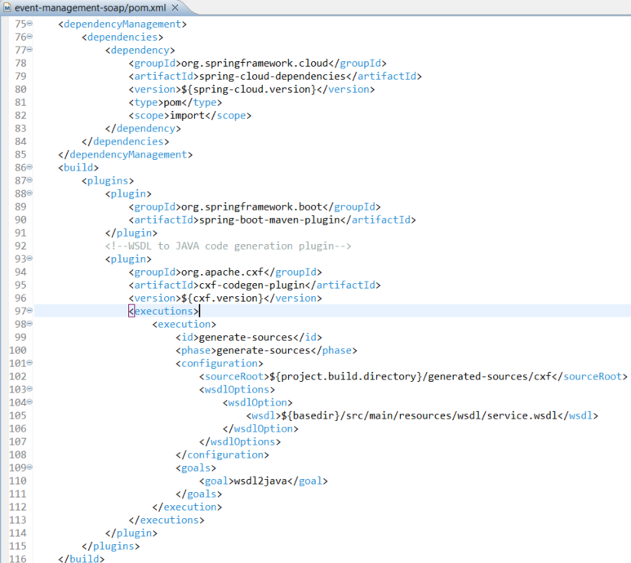
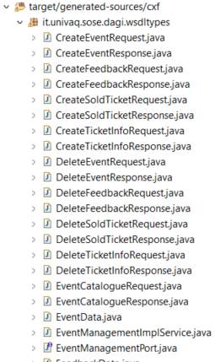
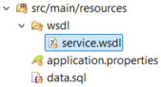
Pom.xml: SOAP provider
This plugin is used in generating Java code from which to implement a service.

Slide 13
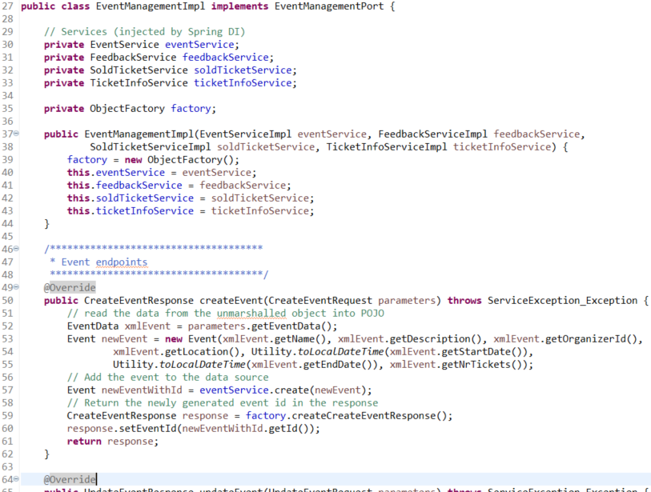
Pom.xml: SOAP provider
The SOAP service is created by implementing the generated interface. For example, in lines «50-61» , an event is created by adding:
Name.
Description.
OrganizerId.
Location.
Start/End date.
Number of tickets.
In line «57» the event is recorded in the DataBase.

Slide 14
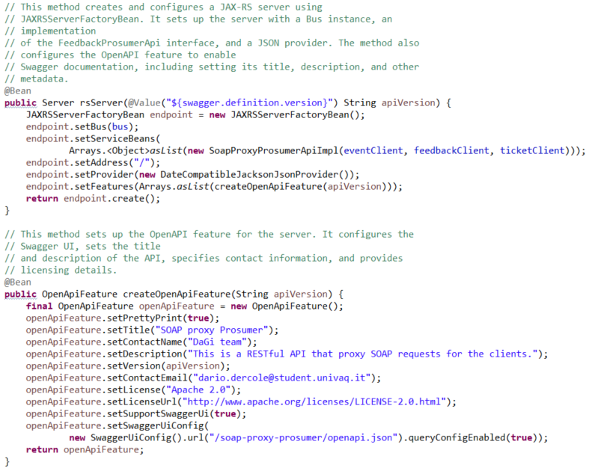
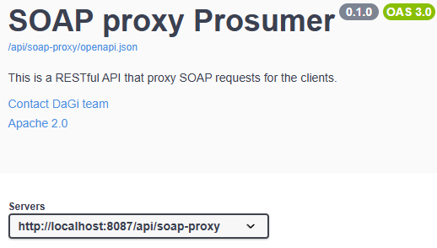
Swagger definition
From the properties file on the configuration repository.

Slide 15
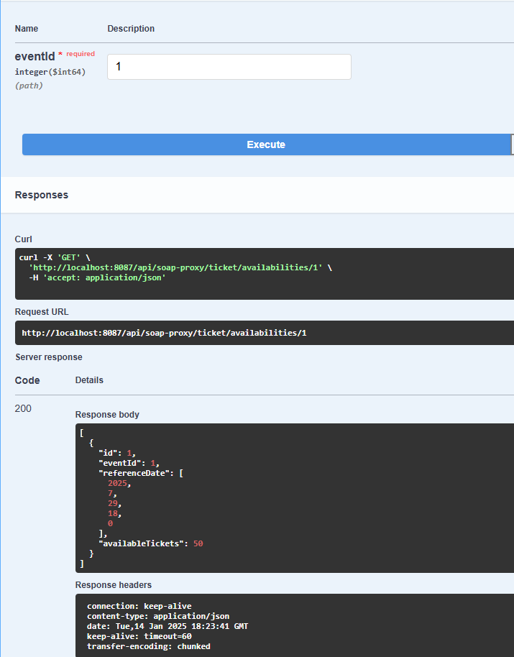
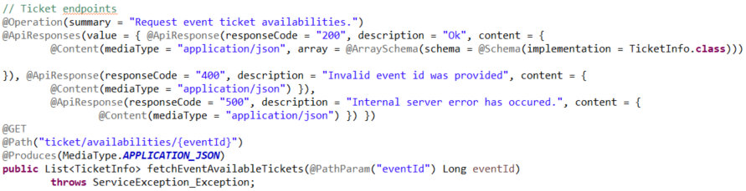
Swagger definition
All the REST services make use of these annotations to generate Swagger documentation and testing UI.
In this example we test the endpoint that returns tickets available for the event with ID «1», using the generated UI.
After the call, it’s possible to see that as a result, we have:
The ID of the ticket.
The Event ID.
The reference date of the Event.
The available tickets.

Slide 16
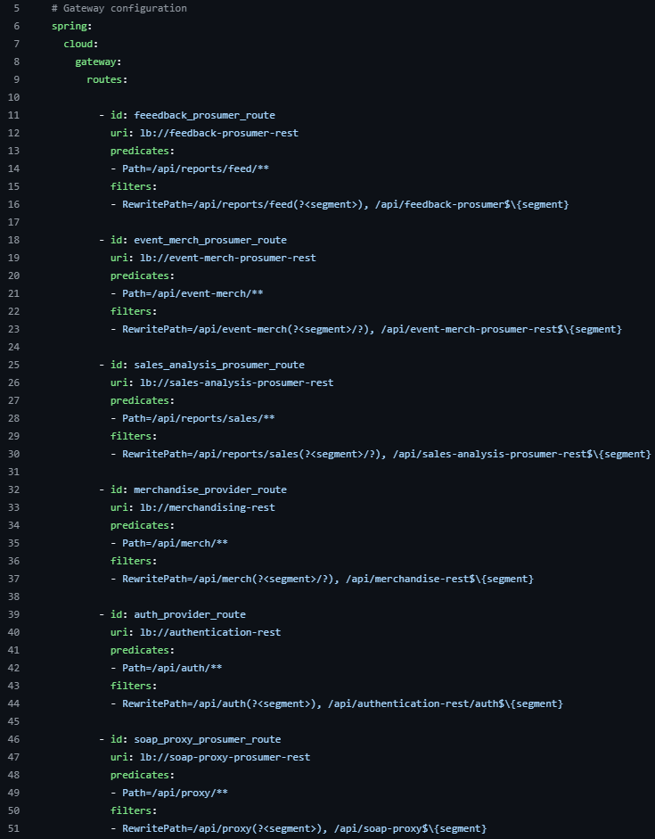
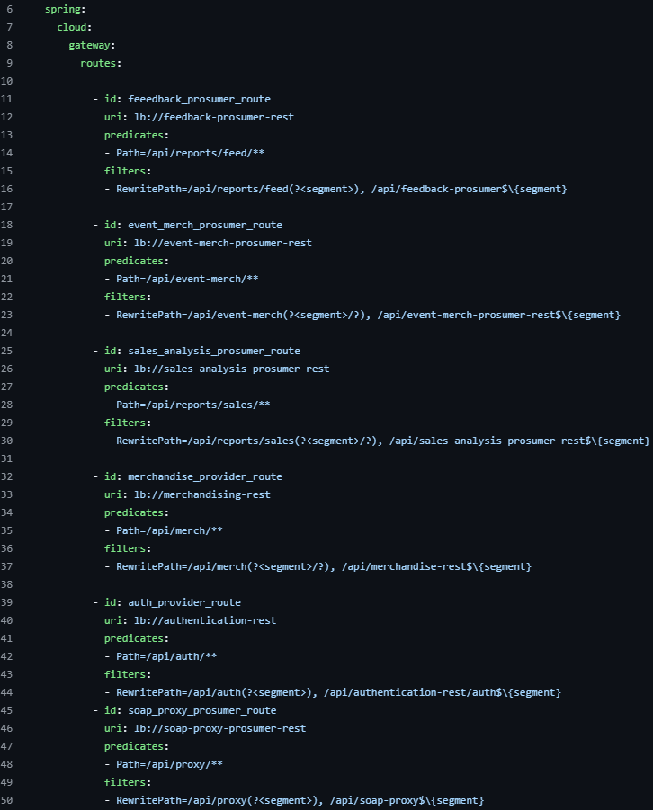
Explanation of all services: APIGateway
«id»: Identifies a route (used mainly for logging).
«uri»: The URI to forward a request to. Since the gateway make use of load balancing, we specify «lb://name-of-spring-app» and the gateway will query the discovery server for an instance of the service automatically.
«predicates»: Specifies a regular expression to match requests against. On match the request will be forwarded using this route configuration.
«filters»: Specifies filters to apply on the incoming requests before forwarding. In our case we rewrite the path so that the internal paths are masked to the public.

Slide 17
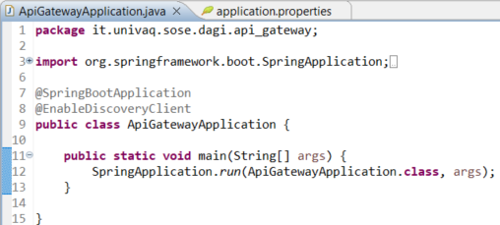
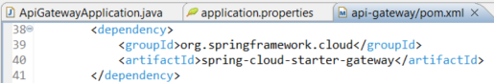
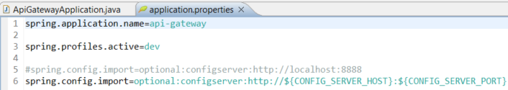
Explanation of all services: APIGateway

Slide 18
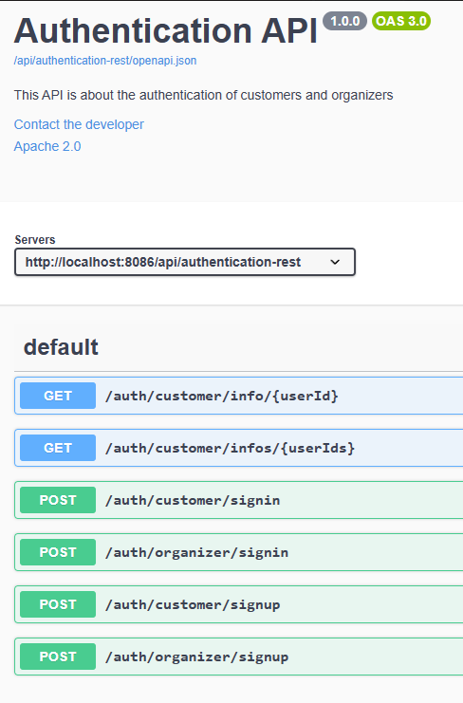
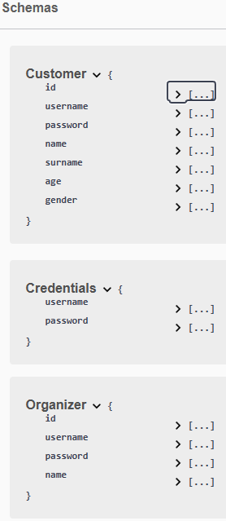
Explanation of all services: AuthenticationREST
This service provides an API to:
Sign-in, Sign-up and information retrieval (GET methods) on the customer.
For the «schemas» part:
«Customer» and «Organizer» defines data needed for the respective Sign-up process.
«Credentials» defines data needed for the Sign-in process.

Slide 19
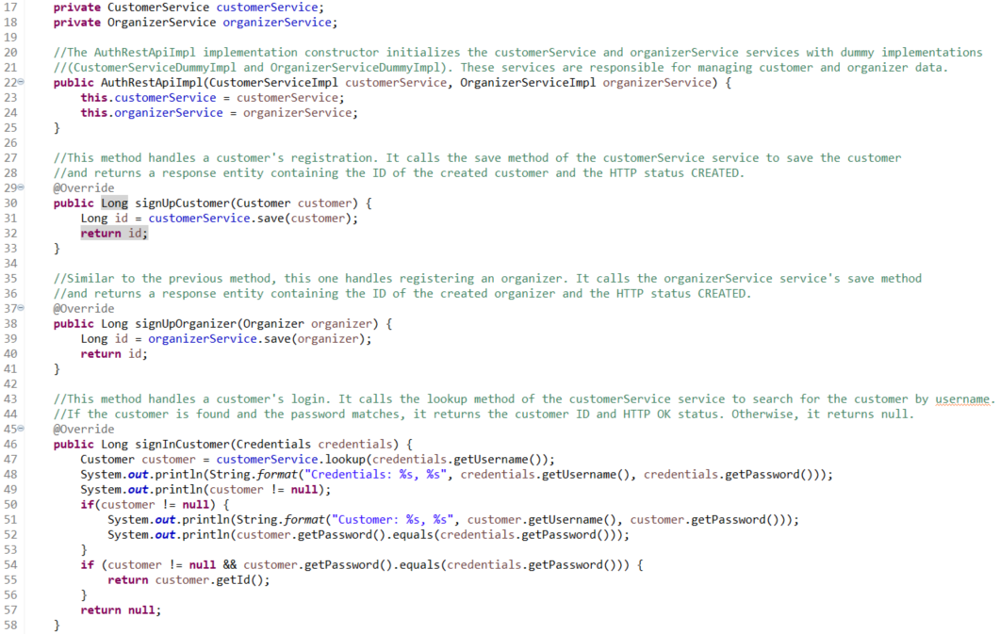
Explanation of all services: AuthenticationREST

Slide 20
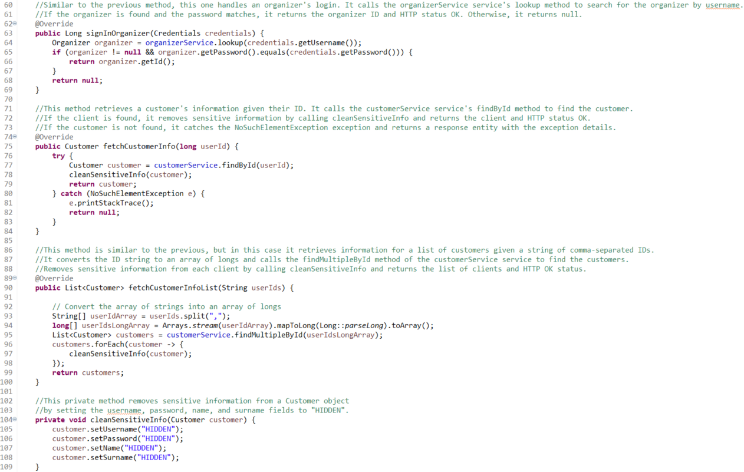
Explanation of all services: AuthenticationREST

Slide 21
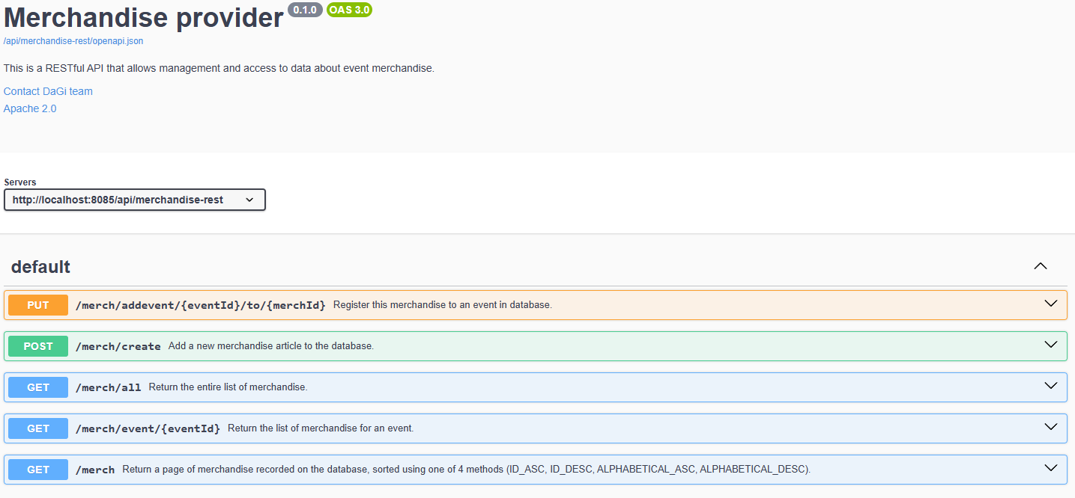
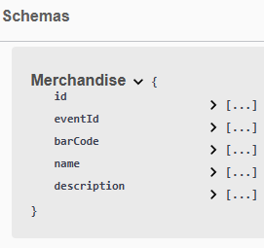
Explanation of all services: MerchandiseREST
This service provides an API to:
Create a new merchandise item.
List all the items added or a page of them with a provided order.
Associate/disassociate an item to an event.
Retrieve all the merchs associated to an event.
For the «schemas» part:
«Merchandise» defines all the info needed for the items.

Slide 22
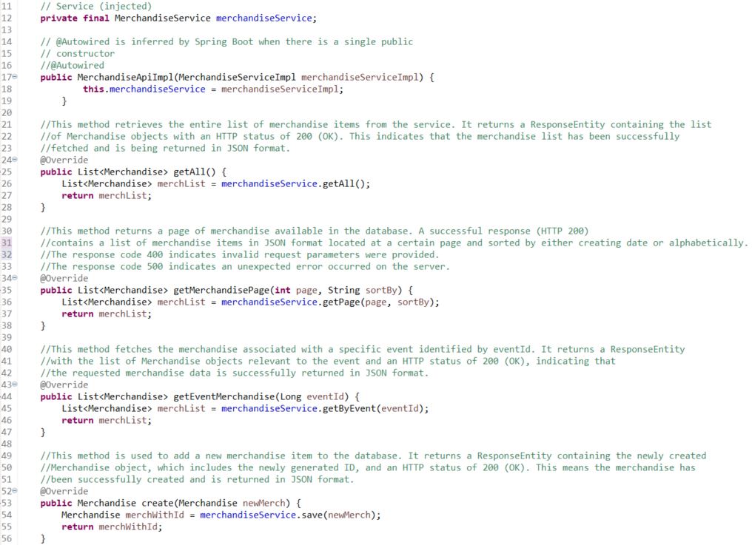
Explanation of all services: MerchandiseREST

Slide 23
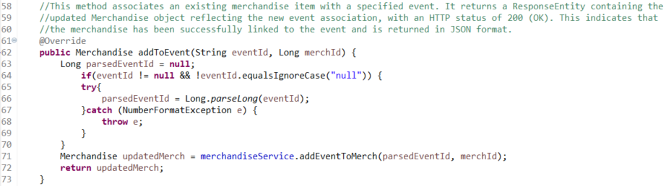
Explanation of all services: MerchandiseREST

Slide 24
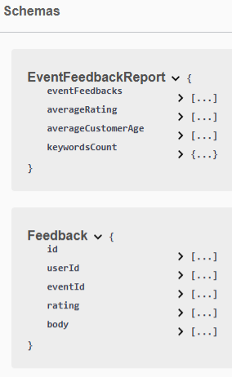
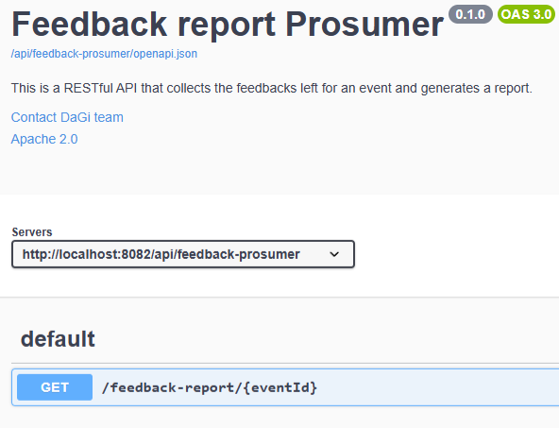
Explanation of all services: FeedbackProsumerREST
This service provides an API to:
Generate report on the feedback/s received by an event.
For the «schemas» part:
«EventFeedbackReport» defines all the fields needed to generate the report.
«Feedback» defines an instance of feedback left by a customer, contained in the «eventFeedbacks» property of EventFeedbackReport.

Slide 25
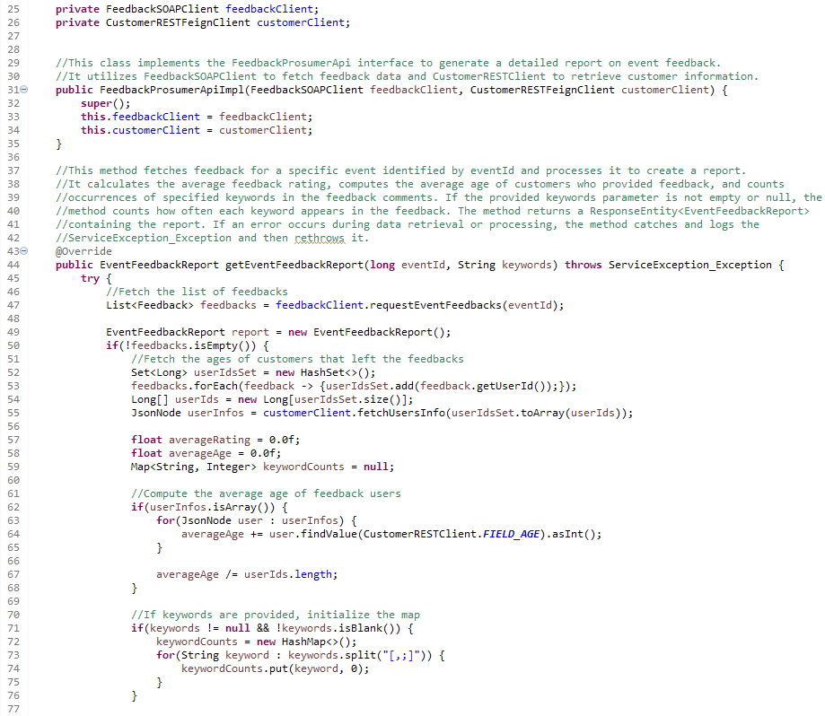
Explanation of all services: FeedbackProsumerREST

Slide 26
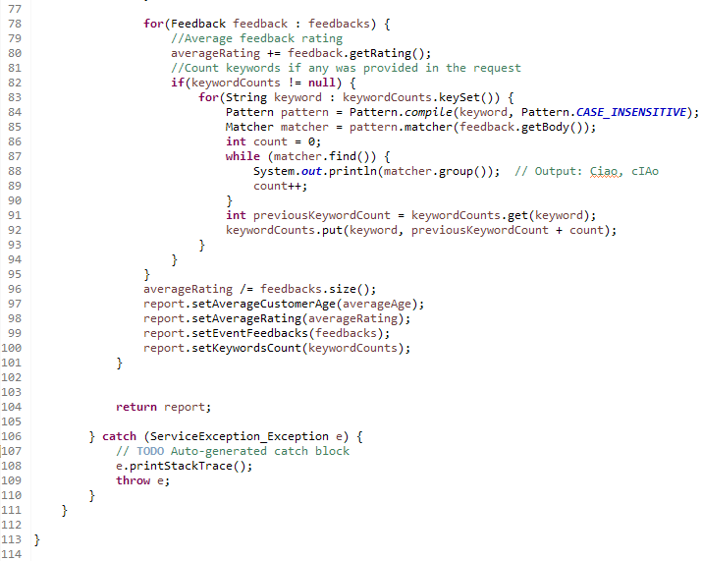
Explanation of all services: FeedbackProsumerREST

Slide 27
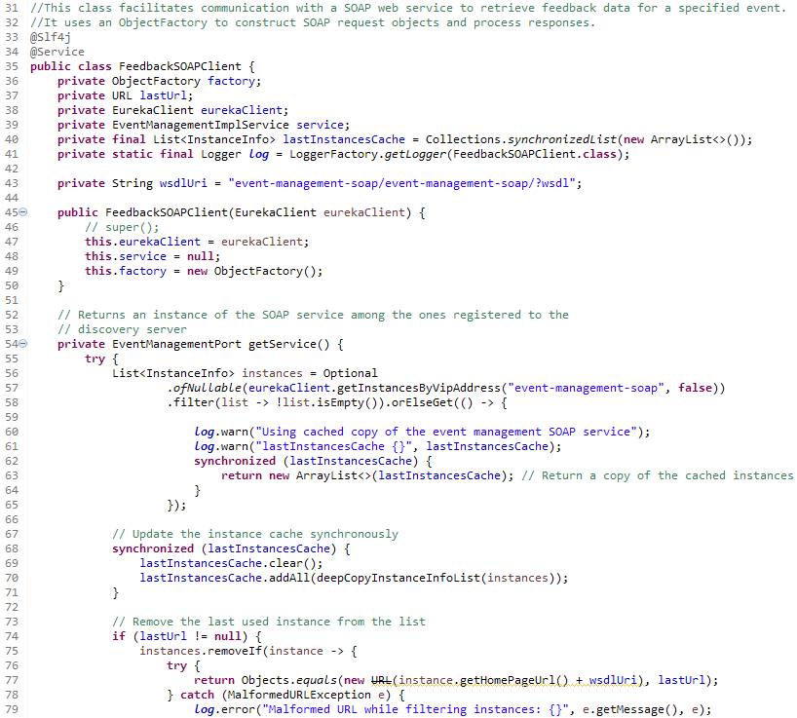
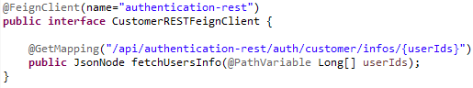
Explanation of all services: FeedbackProsumerREST
This method is responsible for the client-side load balancing of the SOAP service, implementing a round-robin strategy for the selection of the service instance. The next instances will be shown collapsed as the code is identical.

Slide 28
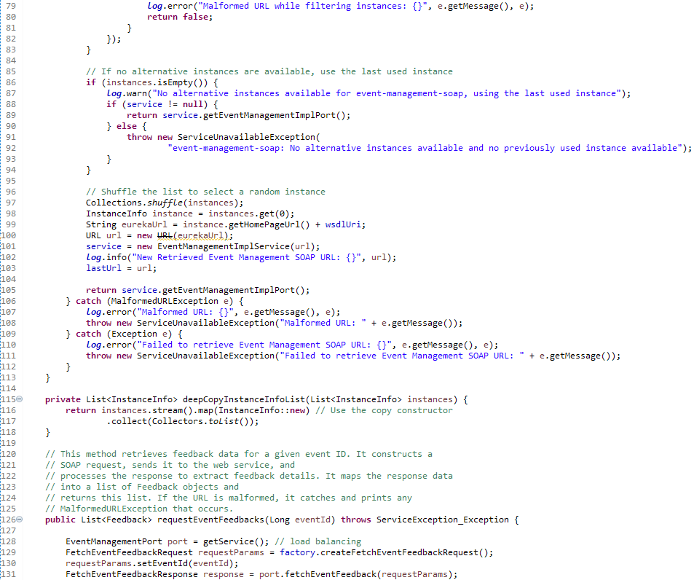
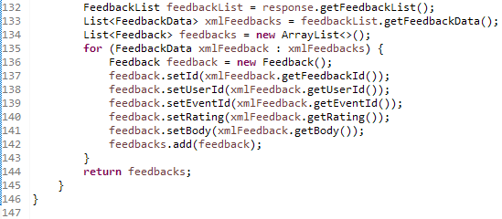
Explanation of all services: FeedbackProsumerREST
\

Slide 29
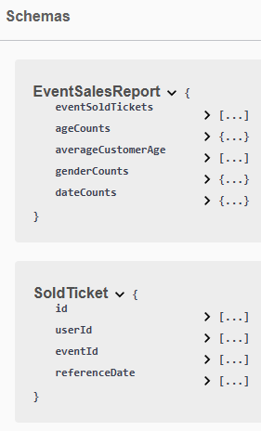
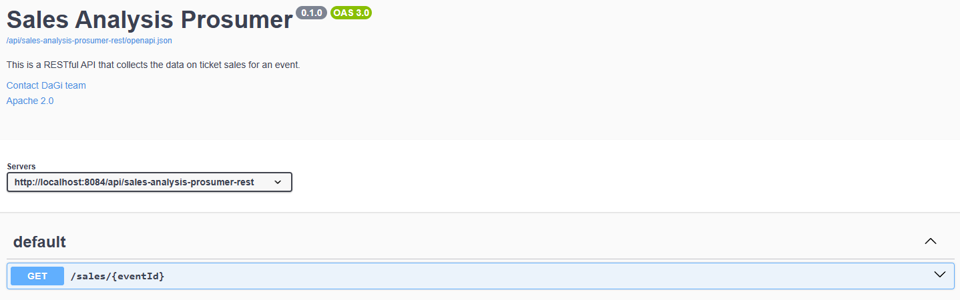
Explanation of all services: SalesAnalysisProsumerREST
This service provides an API to:
Generate a report on the tickets sold for an event.
For the «schemas» part:
«EventSalesReport» defines all the fields needed to generate the report.
«SoldTicket» defines an instance of ticket sold to a customer, contained in the «eventSoldTickets» property of EventSalesReport.

Slide 30
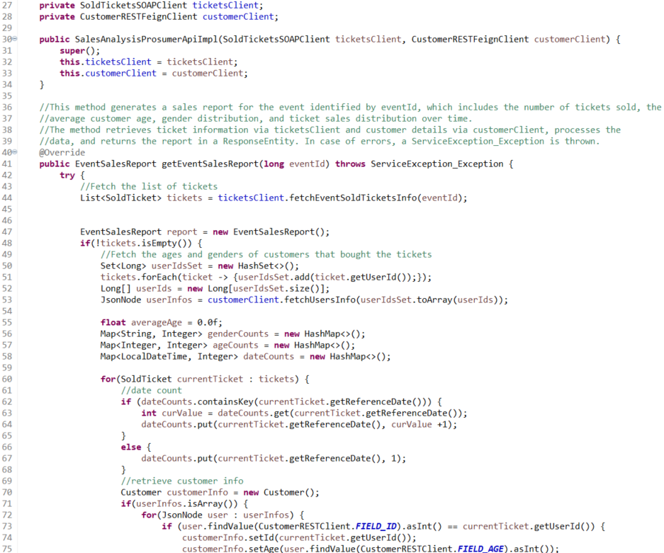
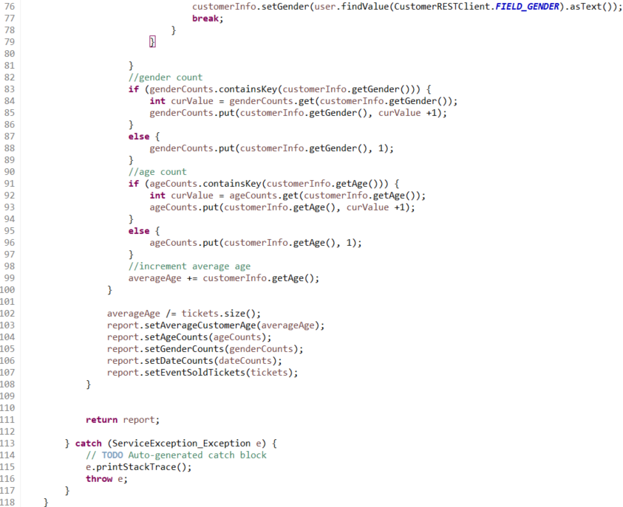
Explanation of all services: SalesAnalysisProsumerREST

Slide 31
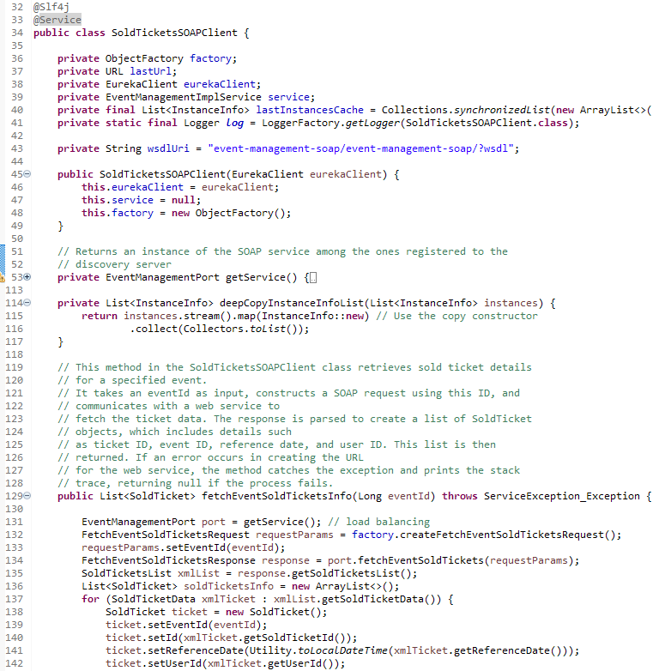
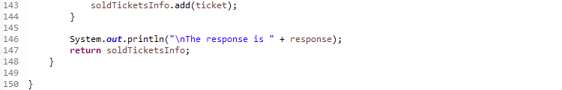
Explanation of all services: SalesAnalysisProsumerREST

Slide 32
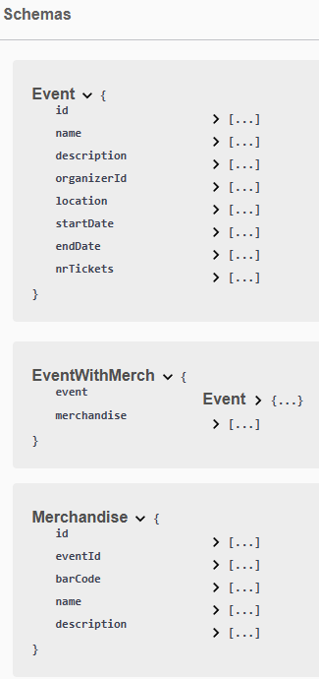
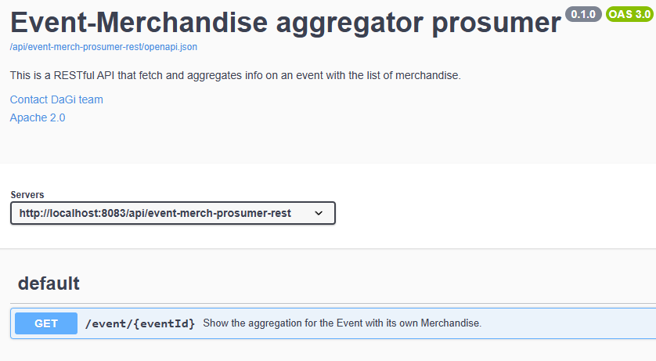
Explanation of all services: EventMerchProsumerREST
This service provides an API to:
Retrieve the information of an event along to the merchandise list.
For the «schemas» part:
«Event» defines an instance of event registered on the system.
«EventWithMerch» defines the aggregated data.
«Merchadise» defines an instance of merchandise listed for an event.

Slide 33
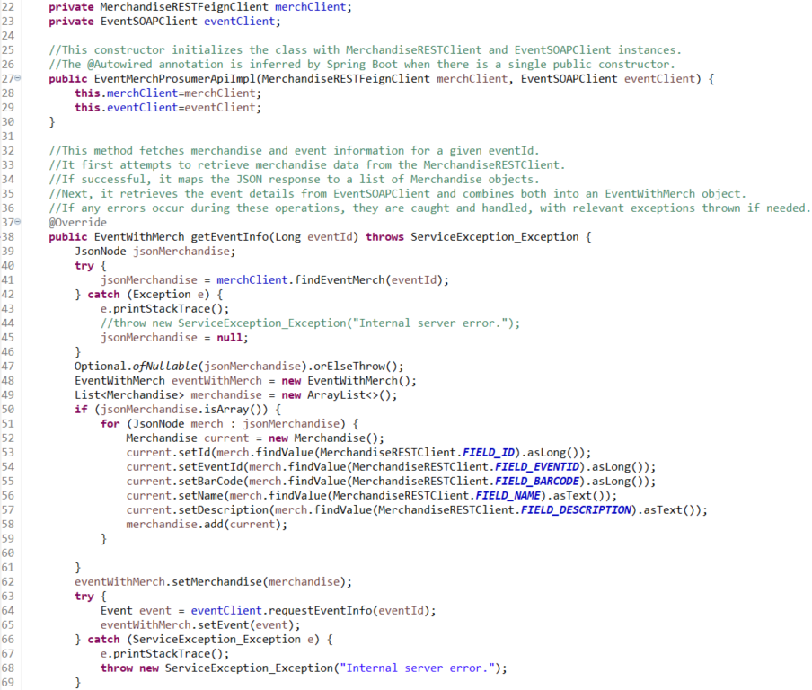
Explanation of all services: EventMerchProsumerREST
The code makes sure that the value of the JSON is not null (if not, it raises an exception, i.e. NoSuchElement).
A new object and an empty "merchandise" list are created to contain objects of type "Merchandise".
If the JSON is an array, then for each JSON node a new object is created.
All fields of the «Merchandise» object are set with the values ​​found in the current JSON.
After populating «current», this object is added to the list.

Slide 34
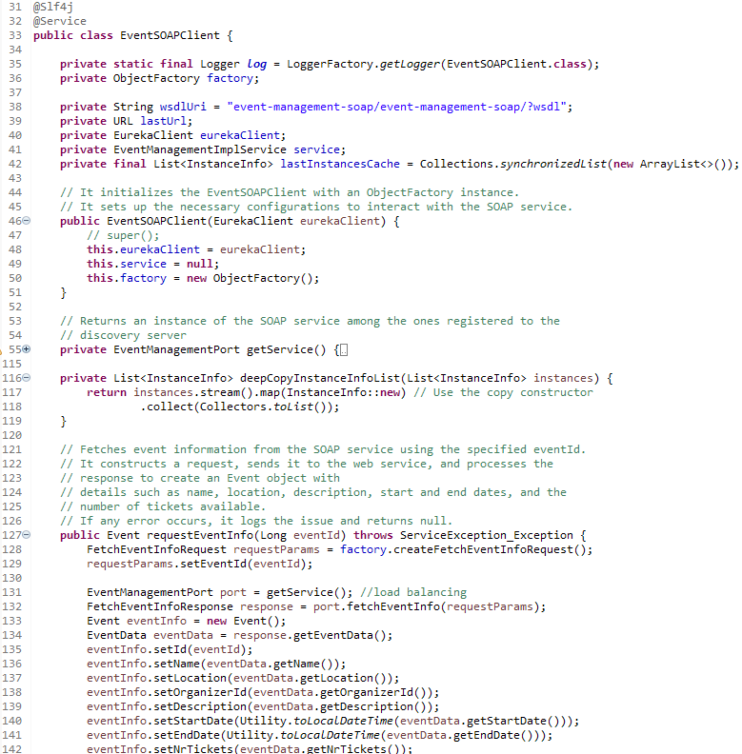
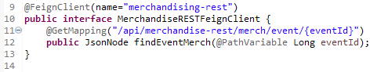

Explanation of all services: EventMerchProsumerREST
Defines a Feign client that sends a GET request to the "merchandising-rest" service, to retrieve information about past events, based on IDs. The response is returned in JSON format.
Initialize the «Eureka» client and create a new instance of the ObjectFactory.
It retrieves information using eventID.
Create a request by setting the event ID.
Send the request to the SOAP service.
Receives a response containing the details of the event.
Returns the Event object.

Slide 35


Explanation of all services: SOAPProxyProsumerREST
This service provides an API to:
Create an event.
Create a ticket for an event.
Request the event catalogue.
Request a customer’s ticket history.
Request the available tickets for an event.
For the «schemas» part:
«Event» defines an instance of event registered on the system.
«TicketInfo» defines a ticket for an event.
«CustomerHistory» defines all the tickets bought by a customer.
«SoldTicket» defines an instance of ticket sold to a customer.
«Feedback» defines an instance of feedback left by a customer.
Request the event info.
Record a ticket sale.
Request the catalogue of events created by an organizer.
Create a new event feedback.

Slide 36

Explanation of all services: SOAPProxyProsumerREST
Initialize the «Eureka» client and create a new instance of the ObjectFactory.

Slide 37

Explanation of all services: SOAPProxyProsumerREST

Slide 38


Explanation of all services: SOAPProxyProsumerREST
Allows to retrieve an event catalogue page.
Iterates over a list of events creating an EventInfo object.

Slide 39

Explanation of all services: SOAPProxyProsumerREST
Similar to the previous one, but filters events to show only those entered by a specific organizer.
VS
Previous method

Slide 40


Explanation of all services: SOAPProxyProsumerREST
Returns a list of feedback associated with a specific event. For each element of the list it creates a new object and adds it to the final list.
Initialize the «Eureka» client and create a new instance of the ObjectFactory.
Allows to send feedback for a specific event. Create a request with feedback details and return the response.

Slide 41


Explanation of all services: SOAPProxyProsumerREST

Slide 42

Explanation of all services: SOAPProxyProsumerREST

Slide 43




Explanation of all services: EventManagementSOAP

Slide 44


Explanation of all services: EventManagementSOAP

Slide 45


Explanation of all services: EventManagementSOAP

Slide 46


Explanation of all services: EventManagementSOAP

Slide 47

Explanation of all services: EventManagementSOAP

Slide 48

Client side asynchrony in the project

Slide 49

Dockerization of all services: Dockerfile(s)
«From maven:3.9.2-eclipse-temurin-17-alpine: this line specifies the base image from which to build the Docker image. In this case the base image is a distribution of OpenJDK 17.
«WORKDIR /authentication-rest»: Defines the working directory within the container. Each subsequent command will be executed from this directory.
«COPY ..»: copy all the files present in the same directory of the Dockerfile into the working directory of the respective container.
«RUN mvn clean install –DskipTests»: this commands runs Maven to build the project. First, it cleans file that were generated in previous builds) and then installs the project into the repository. With the last option, it’s possible to say that the system has to skip the test(s) during the build process.
«CMD mvn spring-boot:run»: defines the default command that will be run when the container starts.
Note: the operation for setting the Dockerfiles is the same for each individual service. The only thing that change is the working directory within the containers.

Slide 50



Dockerization of all services: Dockercompose

Slide 51


Dockerization of all services: Dockercompose

Slide 52

Dockerization of all services: run the containers

Slide 53

Dockerization of all services: instances registered on the server
From this moment on, we can run the clients to play with the application.

